Slide 1
Journey to your best
Challenge 0 "What's your current version?"

Slide 2
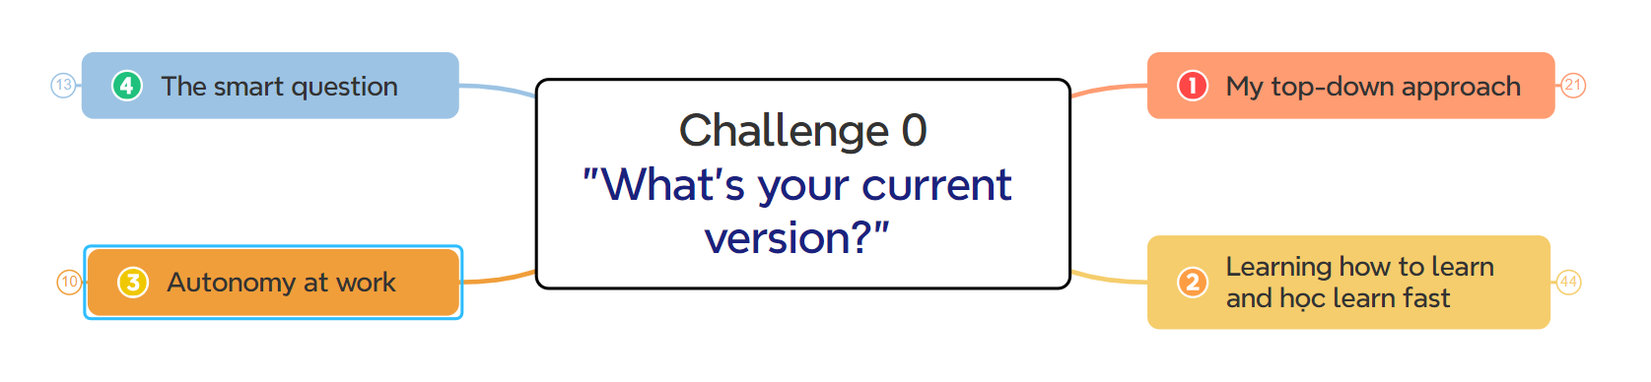
Challenge 0 "What's your current version?"

Slide 3
Top-down approach

Slide 4
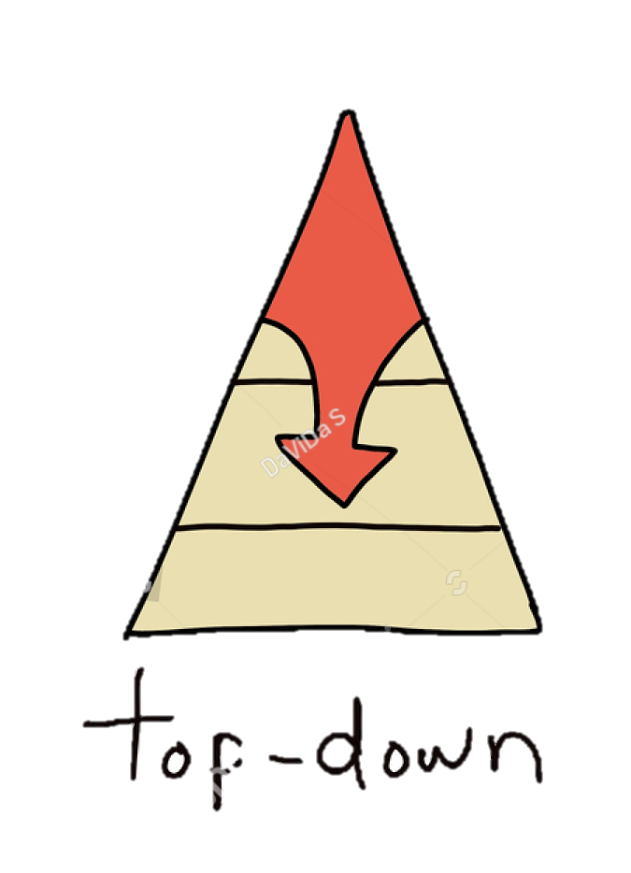
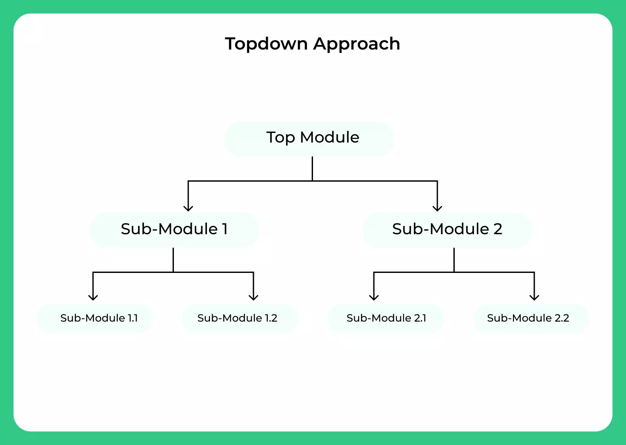
Let's see what people say about the “top-down approach”

Slide 5


What’s top-down approach
topdown approach
“is essentially the breaking down of a system to gain insight into its compositional subsystems”
Start with the big picture (from the most basic, most general thing)
Next: Divide the problem into sub-problems, the sub-problems are divided into smaller (more detailed) problems.

Slide 6
Top-down approach
Advantages
Defects
Easy to understand and implement.
Inflexibility to Changes
Creating information connections
For a new problem, it takes time to penetrate
Enhancing memory retention
Potential for Misunderstanding if the Overview is Inaccurate
Supporting decision-making and problem-solving

Slide 7
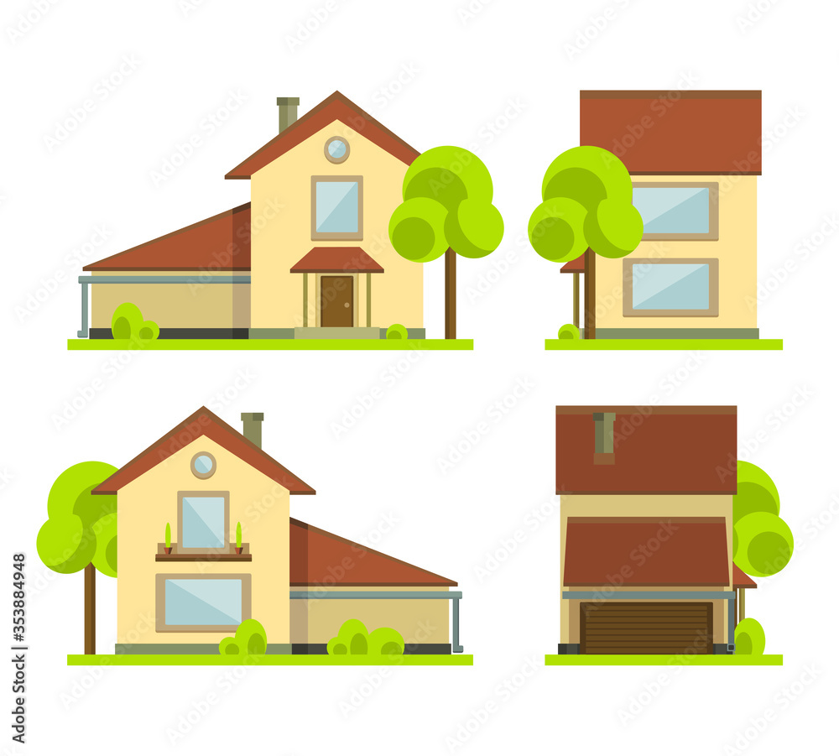

When should a top-down approach
overview

Slide 8
Learning how to learn and learn fast

Slide 9
What’s Learning
Learning is the process of acquiring new understanding, knowledge, behaviors, skills, values, attitudes, and preferences…

Slide 10

Learning how to learn
Focused and Diffuse Thinking
Two types of memory
Beating procrastination
Write to-do lists
Chunking
Best practices
Interleaving

Slide 11


Apply top-down approach
?
Learn fast
Using some tools to research: Chat GPT, Bing Chat...

Slide 12

Autonomy at work

Slide 13
What’s the autonomy at work ?
The employee’s ability to carry out their duties on their own without needing a great deal of outside help or supervision

Slide 14

5 signs an employee can handle more autonomy at work
You Trust Their Judgment
Their Track Record Is Solid
They are Highly Accountable
They Respect Boundaries
They Ask for Help

Slide 15


Why is autonomy important?
No one likes to be micromanaged at work
Help reach employees full potential.
Encourages creativity and innovation
Improves trust and job satisfaction
Promotes skill development
Increase advancement opportunities

Slide 16
Examples of autonomy at work
Letting employees how we accomplish tasks
Letting employees set deadlines
Letting employees set work schedule
Letting employees decide where to work

Slide 17



Slide 18
What's the smart question
is a question that is well-thought-out, clean, and designed to elicit valuable information or insights

Slide 19
How to ask smart questions
input
output
requirement
Think about what you already know
Confirm what you want to ask (what you don't know: can be a suggestion, answer…)
Ensure simplicity and clarity

Slide 20

How
How to apply smart question on your daily basis/work
Set Clear Objectives
Preparation and Research
Prioritize Open-Ended Questions
Practice Active Listening
Encourage Feedback

Slide 21
Thank you

